Slide 1
A novel method for sampling points in a room

Slide 2
Problem description
Normal sampling method:
For point cloud in room, because number of point cloud is too big, usually a room would be broken into lots of blocks. A fixed number of points would be randomly sampled from each block as a batch of data.
Disadvantage:
Most points in a room belongs to ceiling, floor and wall. The situation cause a result that the final prediction has a high accuracy for these 3 classes but a low accuracy for the rest class like chair, bookcase or table, since the number of points belonging to ceiling, floor and wall overwhelm other classes.

Slide 3
Proposed idea
The basic idea is that since (1):big part points of ceiling,floor and wall are within a plane, so these points’ norm direction should be almost parallel. (2) wall, ceiling and floor have a very big area compared with other object in a room like chair or table. Making use of these properties, I hope to figure out a method to mark points which may potentially belong to ceiling, floor and wall before sampling points. The method is introduced blow:
Downsampling points by VoxelGrid filter.
Geting every point’s norm after downsampling.
For each point, take k nearest neighbors of it and check all those point’s norm. If their norm direction is very uniform, we mark this point as a point belong to ceiling,floor or wall
When we do the sampling for a batch of data, those marked point should have a lower probability to be picked.

Slide 4
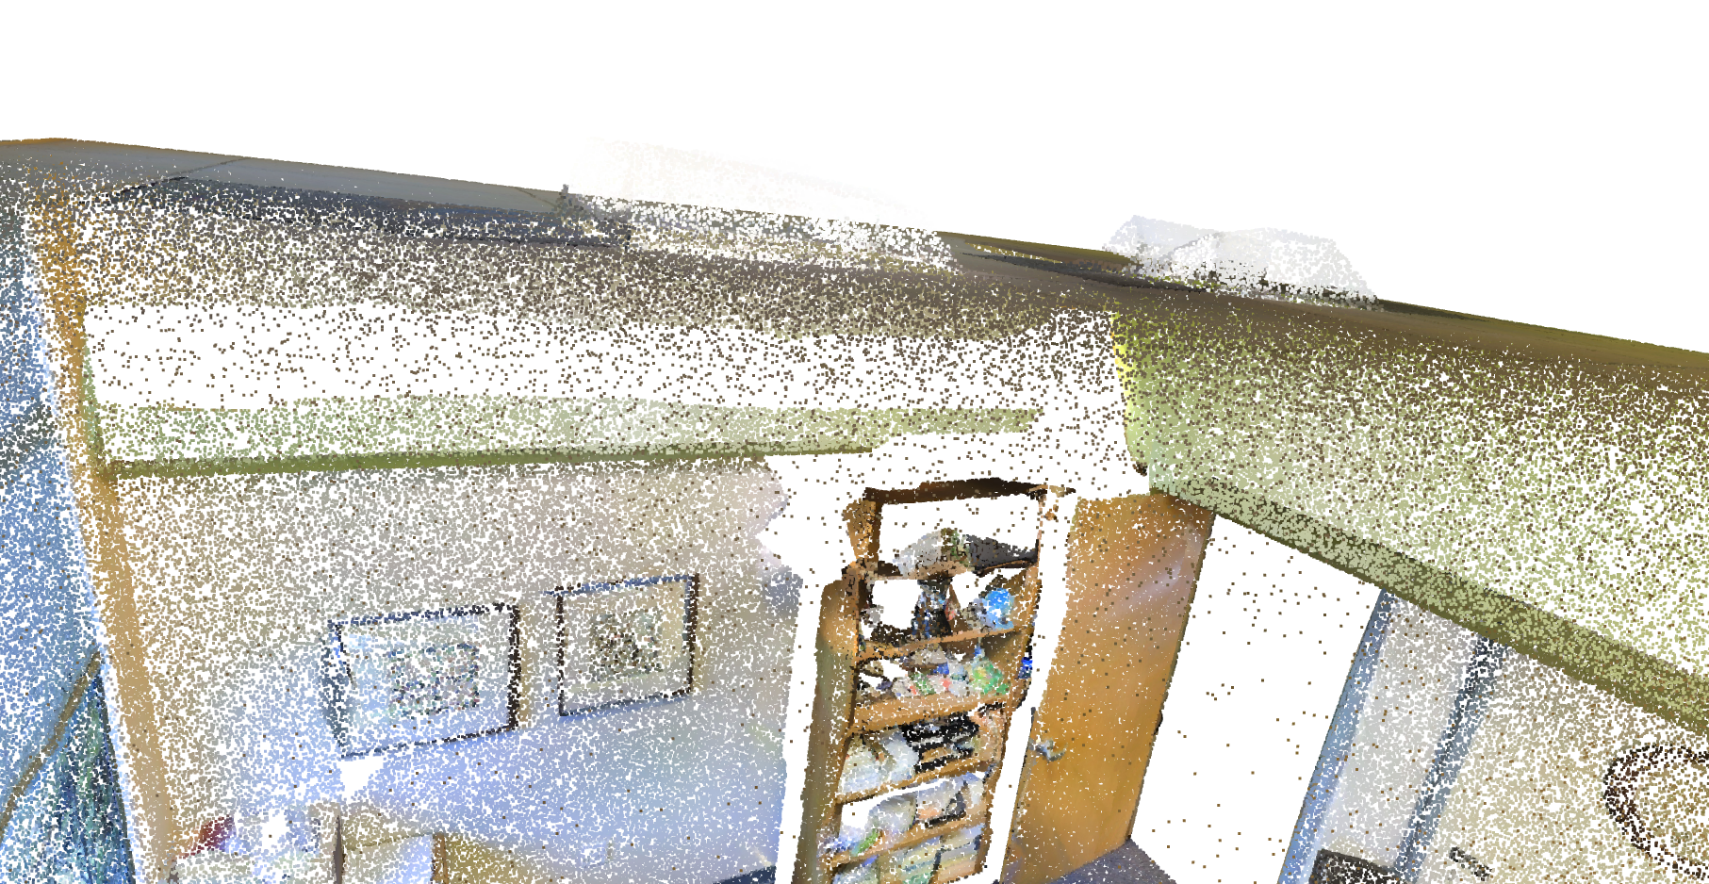
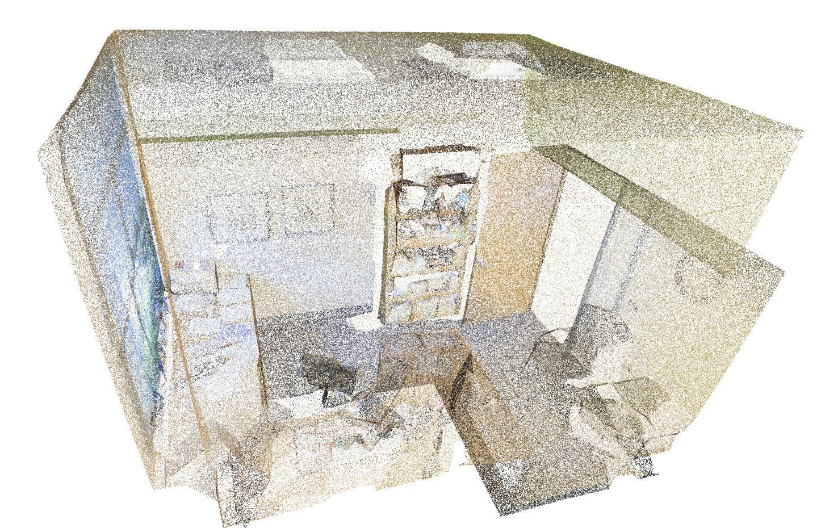
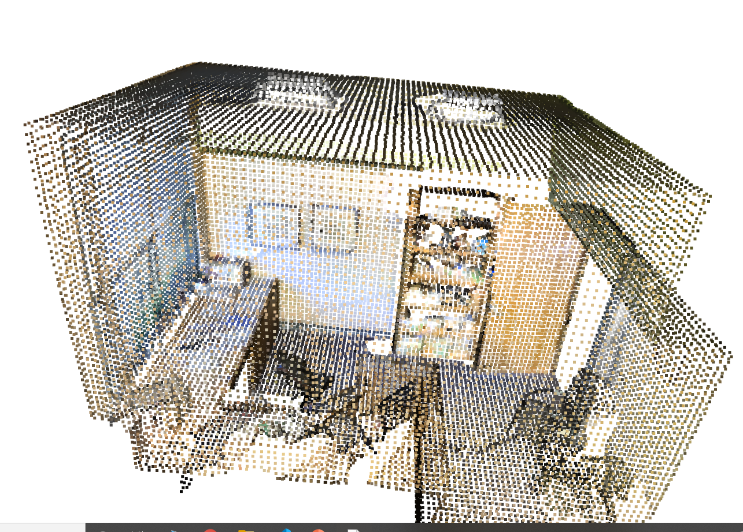
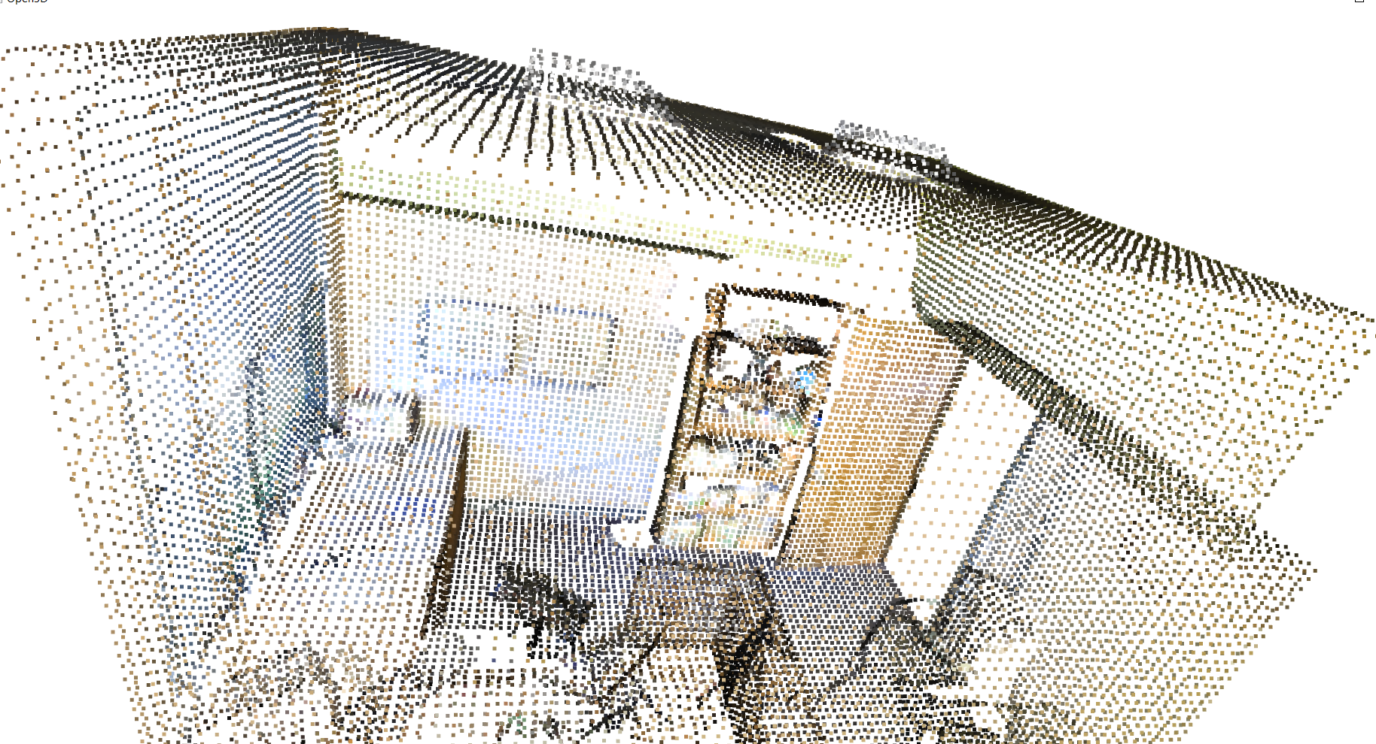
Voxelgrid downsampling
Before voxelgrid downsampling
After voxelgrid downsampling
Result: going through a voxelgrid donsampling make points more regular, which also greatly present a surface

Slide 5
Norm direction’s Unity in k nearest neighbor
For each point, finding out K nearest neighbor point and their norm direction
Calculate cos angle between each norm of neighbor and the point
The angle’s range is between 0-180, however, for points in a plane, their norm vector direction may be almost opposite but in the same line, like image shown in Fig.1, the final point is within the same plane as previous 3 point, but norm direction is totally opposite
For this problem, we make all angle which bigger than 90 as angle=180-angle, which compress all angle in a range 0-90, then, the neighbor who are almost opposite to the point would have a small angle with that point.
Finally divide all angle into 9 class, every 10 degree per class, 0-10 degree is class 0, 10-20 would be class 2,….so on. Then, for every point and its k neighbor, we calculate the Shannon entropy of the class, if the entropy is small, that means the classes are uniform.
Set a threshold for the entropy, if the entropy is less than the threshold, the point is marked as a ceiling or floor or wall’s point
Figure 1

Slide 6
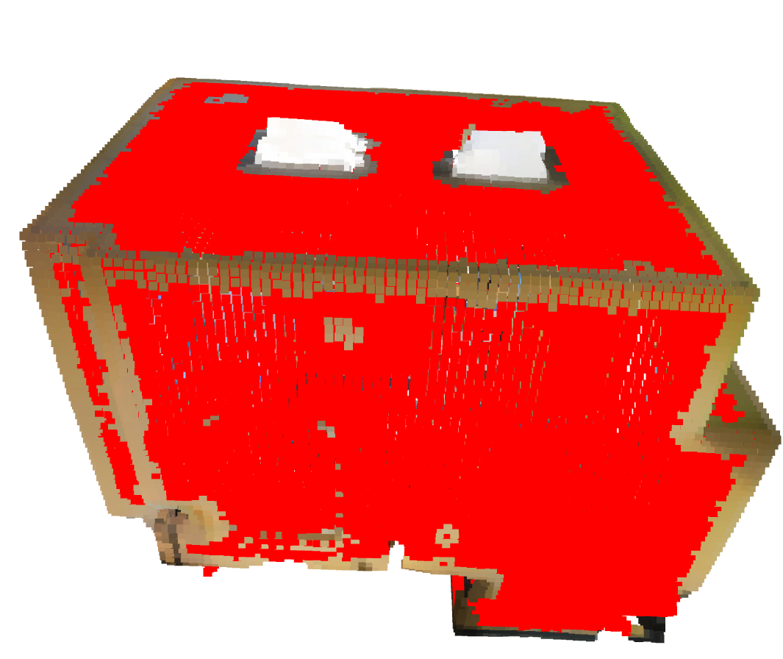
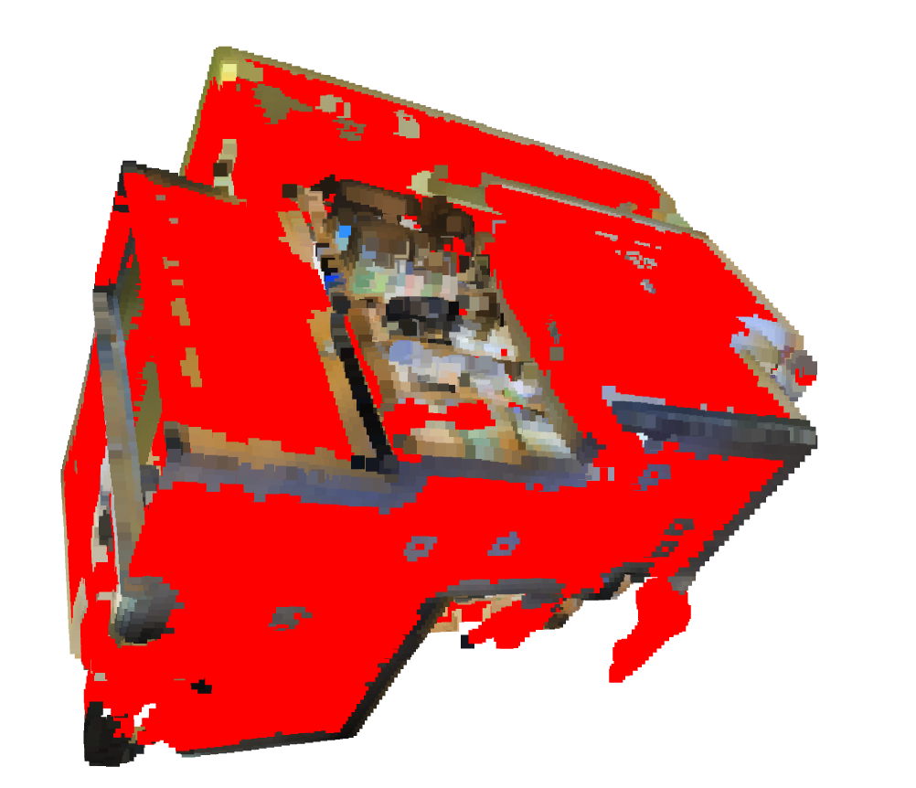
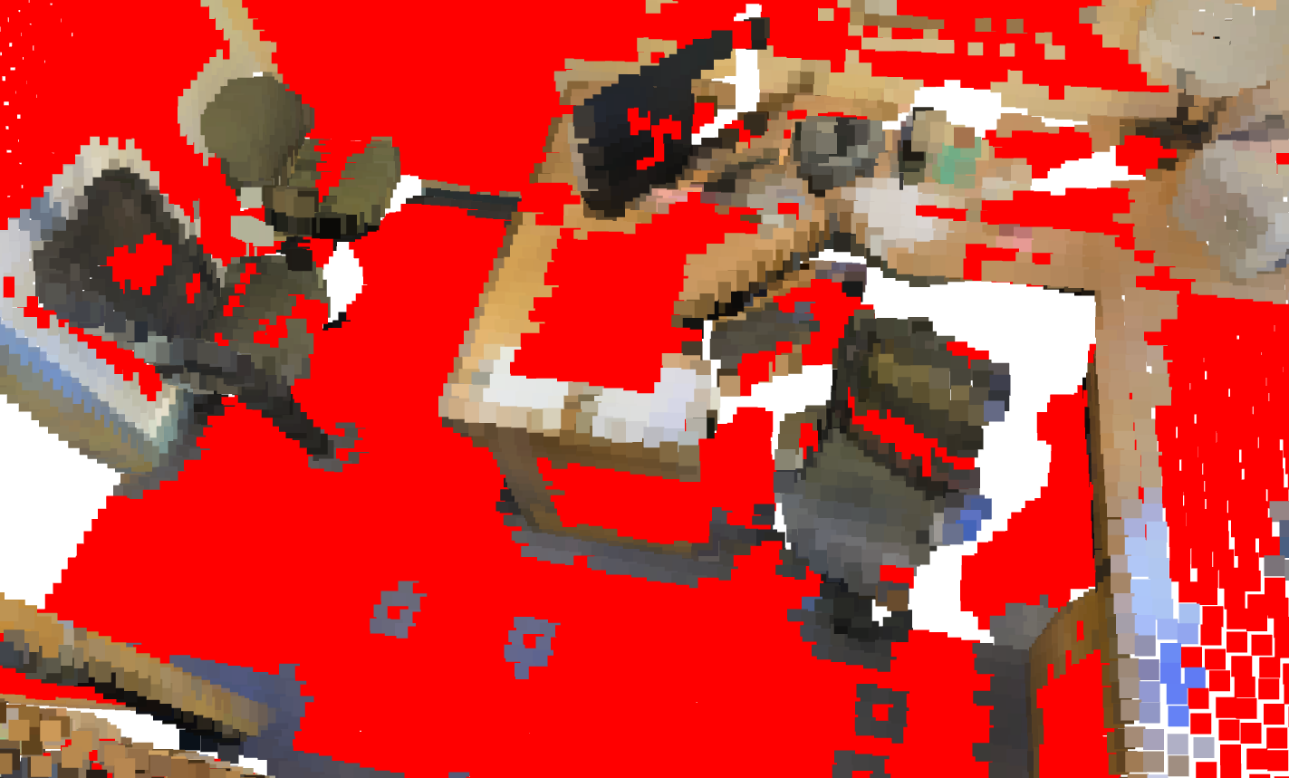
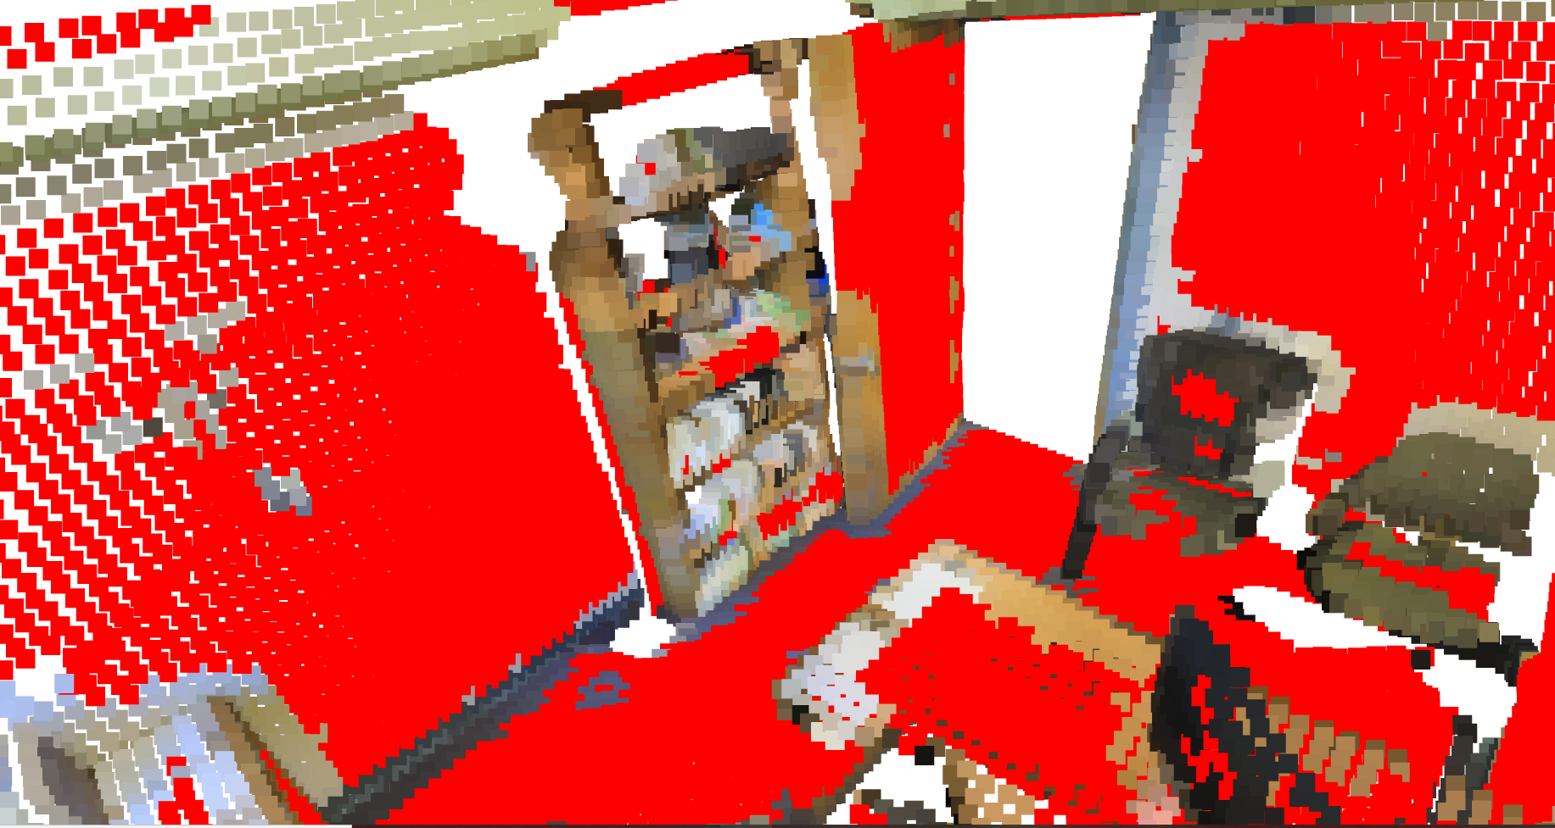
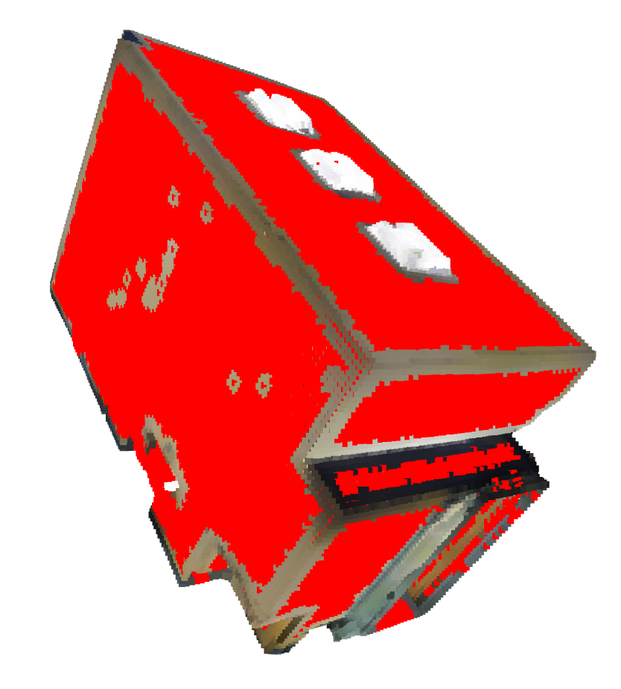
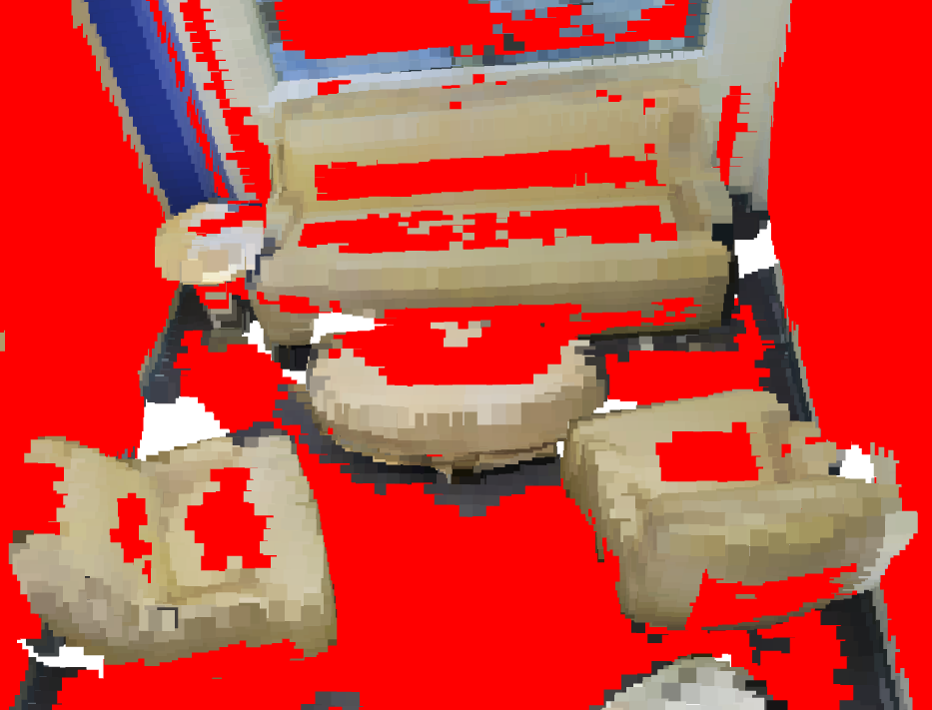
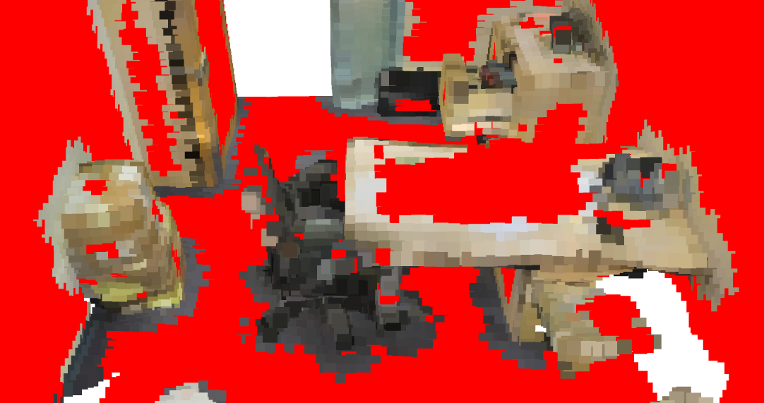
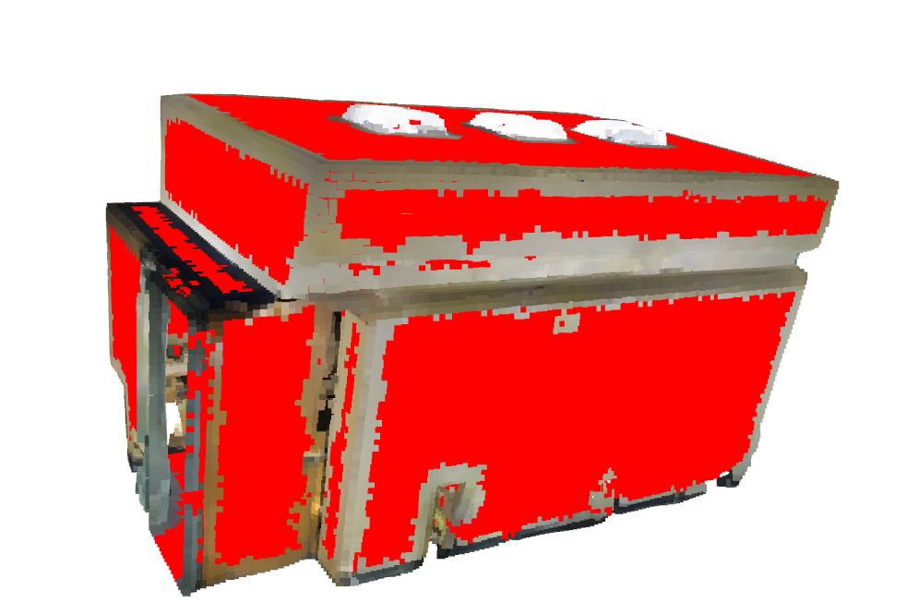
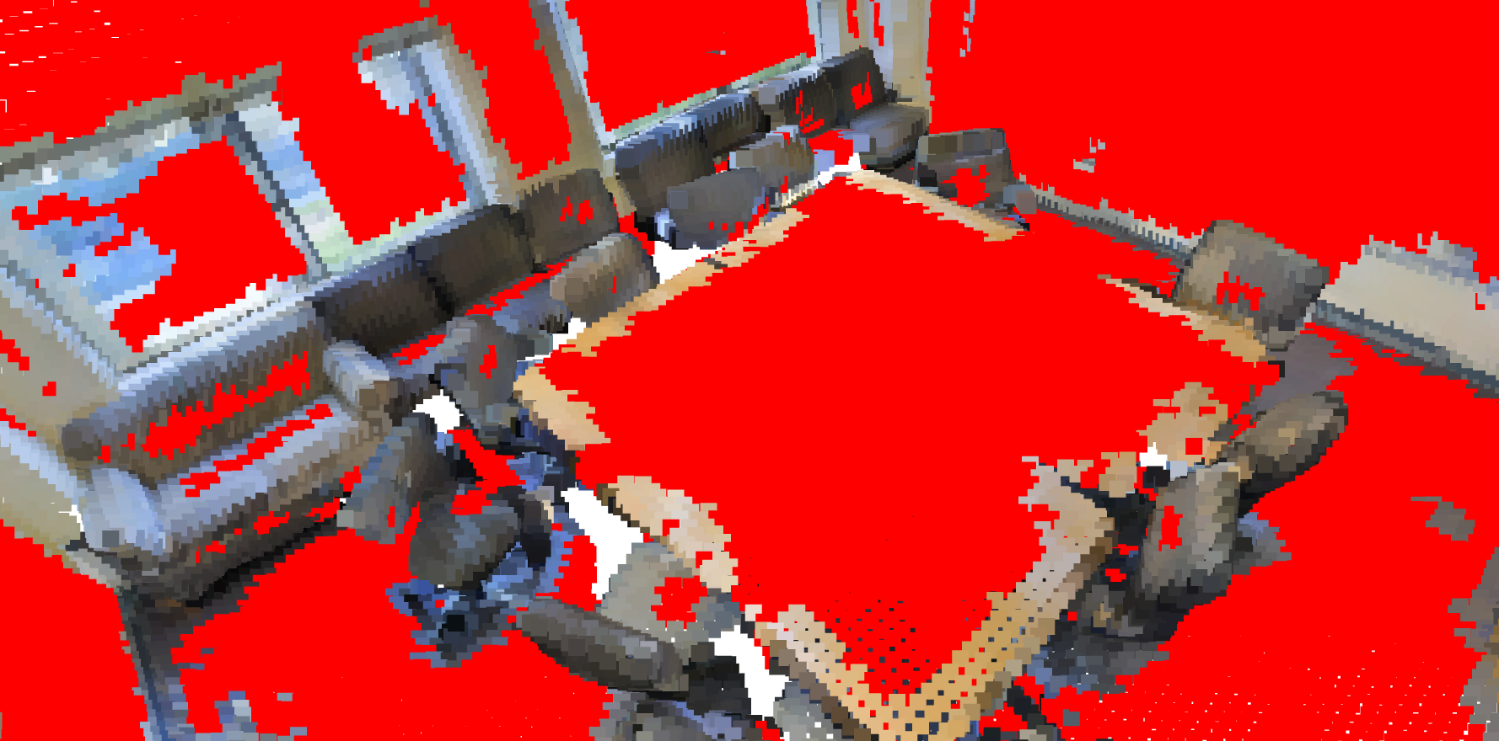
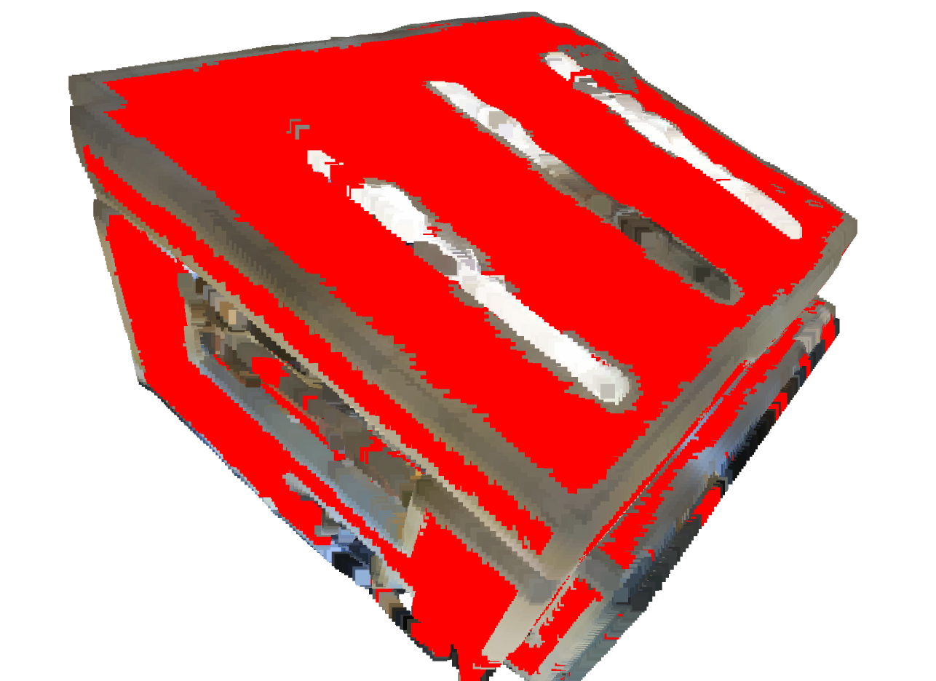
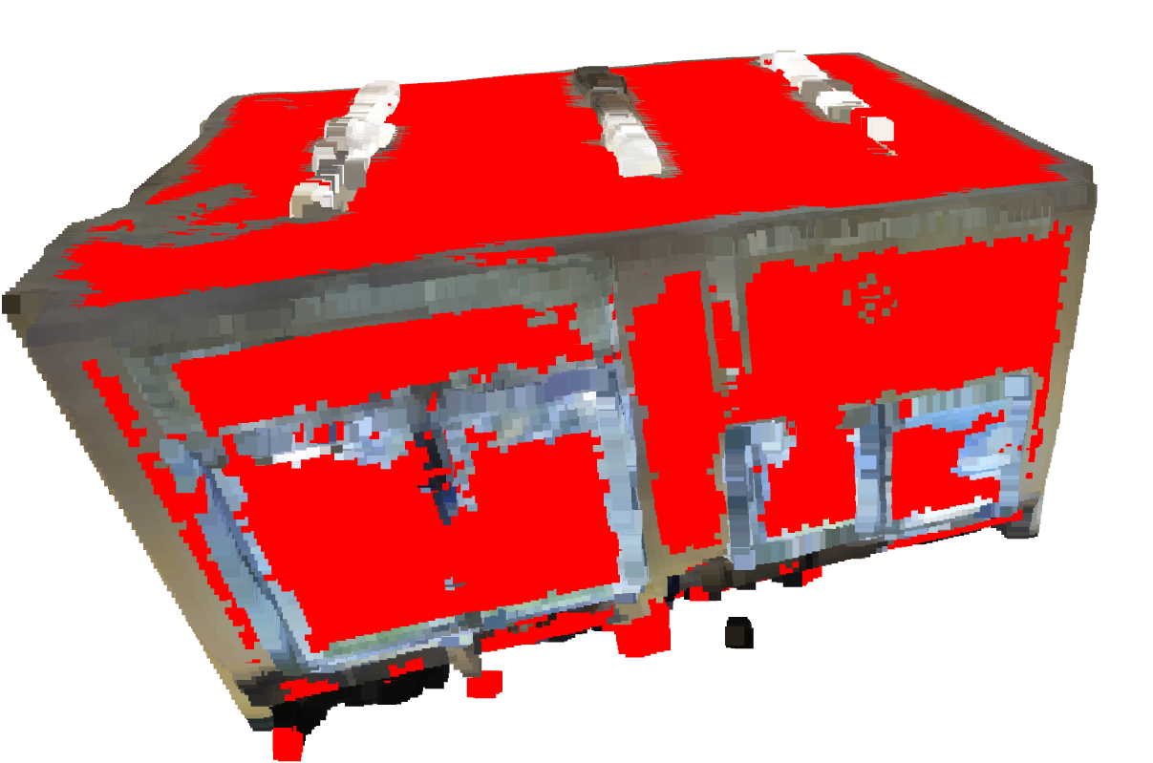
Result showing(red point is marked point)
Sample 1
Sample 2
Sample 3

Slide 7
conclusion
Some place is not strict enough, for example, if a neighbor point has a 45 degree angle with current point and another neighbor has a 135 degree, my algorithm would judge these 2 neighbors belong to the same class(norm direction is on same line), but in fact they are not.
Even though some place is not strict enough, as the result shows on previous slice, most red point(marked point) are on big planes. Most part of wall,ceiling and floor is marked red, while just small part of chair and bookcase are marked as red

Slide 8
Following work
Once we have the marked point ,next thing should be considered is that how to sample marked point and unmarked point, 2 potential strategy is given below:
set a higher sample probability to unmarked point and a low sample probability to marked points in a batch. However, how much those probability should be?
In every batch, we first pick up unmarked point. Only when unmarked point is used out, we start to sample marked point.
I prefer to use the second strategy, since the number of marked point is obviously much bigger than unmarked point, that means in lots of case, in a batch, most point are red point, we have no idea but just do a random sample for those red point(marked point)

Slide 9
Experiment plan
Once the whole sampling algorithm is finished, I would pick up some Deep learning based point cloud segmentation to do experiment. For those method, they should use local information to do prediction just like Pointnet++ or DGCNN. I would collect experiment result of randomly sample method and my sample method. The comparison item are listed based on priority
Dose Small object’s accuracy increase? How much increase?
Do wall, ceiling and floor accuracy decrease? How much decrease
What’s the overall accuracy change
What’s the MIOU of classes changes

